Slide 1

TrayTrak
A Medical Device Tracking App
A unified, comprehensive platform for seamless end-to-end medical device tracker

Slide 2
Introduction
“TrayTrak is a smart tracking solution designed for a medical device distributor. It enables real-time monitoring of device movement, who dropped it, when, and where, ensuring complete visibility. Built with Flutter, the mobile app boosts operational efficiency with seamless, intuitive tracking.”

Slide 3

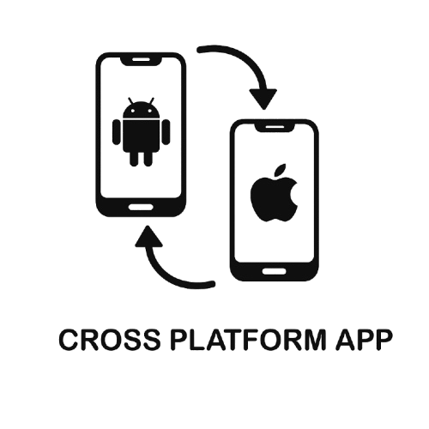

Platform Vision - What We’re Building
A tech-powered platform for tracking daily medical device movement
Application for both:
(a)Android (b) iOS
Built to be scalable, secure & user-friendly

Slide 4



Platform: Build for iOS and Android
Android App (Admin Team Section + Operational Team Section)
iOS App (Admin Team Section + Operational Team Section)
The primary target platform for the application is iOS, with minimal Android usage (currently only one user).

Slide 5


Targeted User’s & It’s Key Feature
Internal Operational Team
Admin Team
Operational Team Authentication
Drop-off & Pick-up management
Real Time Notification
Activity History (Self)
Escalation or Issue Reporting
Admin Team Authentication
Medical Device Registry
Location Registry
Team Member Registry
Assign Task
Tracking Dashboard
Reports

Slide 6
Department | Tools and Technology
Tech | Flutter
Database | Firebase Firestore
Infra | Firebase
Analytics | Firebase
Crashlytics | Firebase
Notification | One Signal
Tech Stack

Slide 7
Department | Members
Business Analyst | 1
Mobile | 2
Quality Assurance | 1
Project Manager | 1
Devops | 1
Team Members

Slide 8
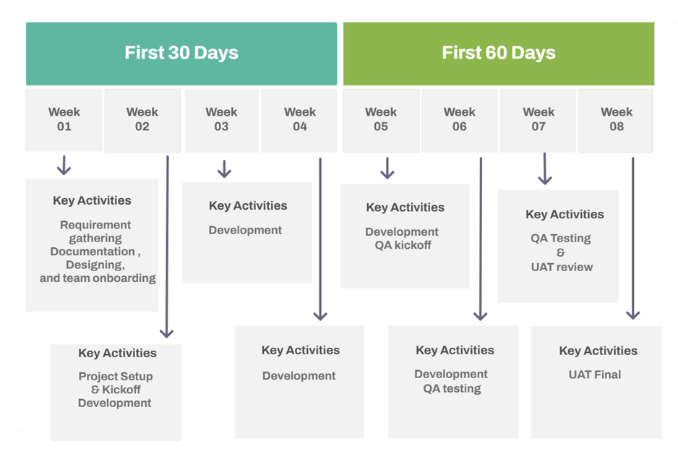
Project TimeLine

Slide 9
Project Costing
TimeLine
Costing
2 Months
$12000
50% After signing the agreement
25% Phase I
25% Phase II

Slide 10
Why Us – Expertise in Product & Domain
Product-led team, not just coders
Experience in building successful
SaaS Products
Start-Ups Idea to monetization model
Long term commitment and scalable delivery
Strong Governance & Communication Mode
Partial Clients are list:

Slide 11
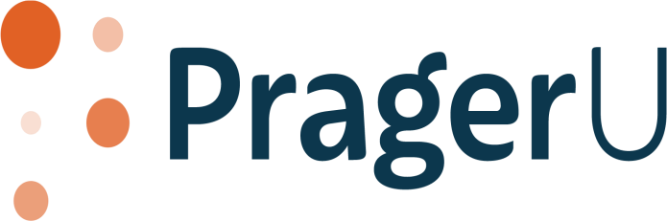

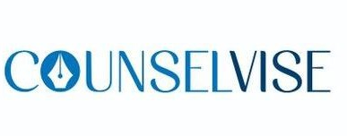





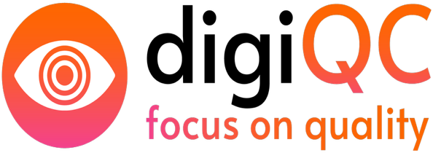


Slide 12
“This proposal offers a cost-efficient, scalable product development approach with a trusted dedicated team.
It combines predictable pricing, agile execution, and a clear vision for transforming property leasing and investment through technology. It ensures ownership, control, and sustained product growth aligned with your business goals”.

Slide 13
Thank You

